Slide 1
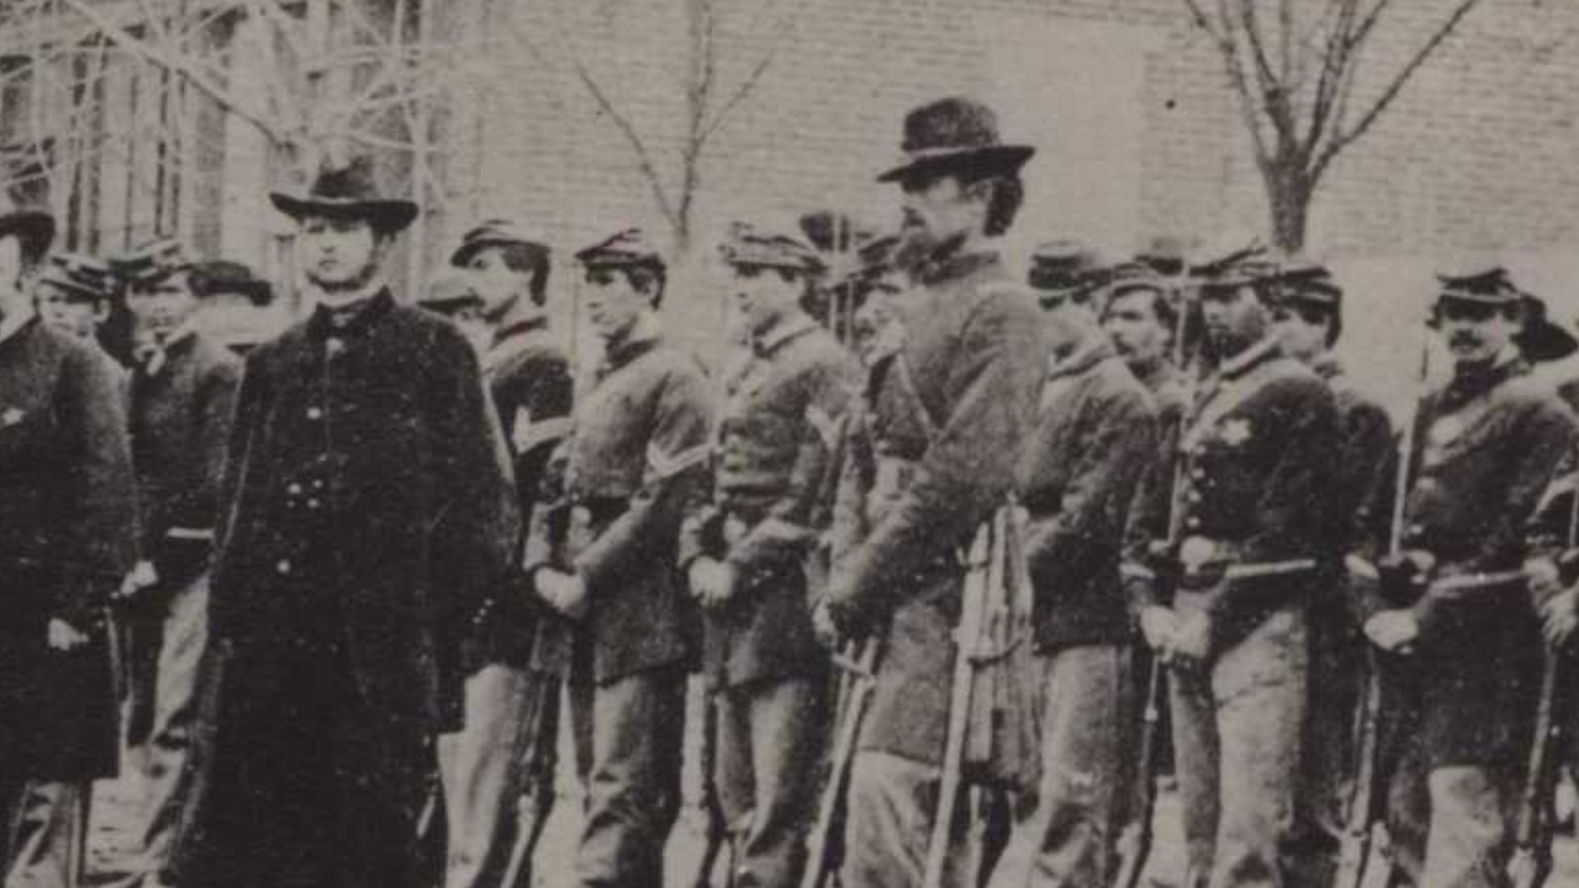
Civil War Calling:
The Lehigh Valley Response
Notes:
The typical soldier fighting for either the Union or Confederate forces was a Caucasian male, born in the United States, unmarried, and aged between 18 to 39, with an average age of 25. Many soldiers on both sides were farmers previous to enlisting, and their motivations for joining the conflict were rooted in a variety of reasons such as patriotism, a strong sense of state pride, the allure of adventure, or the promise of a stable income. As you will see, those who could not join the fight, such as with the case of women, were equally motivated to take action in their own unique ways, whether that was by raising funds, sewing blankets and clothes, or providing medical aid.

Slide 2
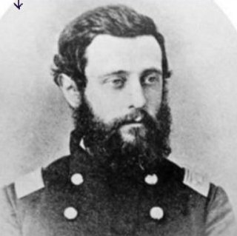
The Lehigh Valley Response
John Fredrick Frueauff
of Bethlehem, PA (1838-1886)
Before the start of the war, John Frederick Frueauff (or “Freddy” as he was known to friends and family), had just finished college and had begun a promising career as a lawyer in Easton, PA.
Following the attack on Fort Sumpter on April 12, 1861, President Abraham Lincoln issued a call for seventy-five thousand volunteer soldiers to serve for thirty days. Freddy was one of the first 500 men to enlist from Pennsylvania (also known as “The First Defenders”) and he began his march to Washington D.C. within four days.
He first enlisted in Company A of the 1st Regiment of Pennsylvania Volunteers as a 1st lieutenant and served for three month of duty. After this, he enlisted again. This time in the 153rd Pennsylvania Volunteers as a Major.
Freddy would see combat at several notable battles including the Battle of Chancellorsville where he was wounded in his leg, and the Battle of Gettysburg, which would be his last battle.
Notes:
For further reading see:
Frueauff, John Frederick, and Daniel R Gilbert. 2006. Freddy's War: The Civil War Letters of John Frederick Frueauff. Bethlehem, Pennsylvania: Moravian College.
Image from: Kiefer, W. R, Newton Heston Mack, Paul Bachschmid, Teresa Pierson, and William Simmers. 1996. History of the One Hundred and Fifty-Third Regiment, Pennsylvania Volunteers Infantry : Which Was Recruited in Northampton County, Pa., 1862-1863. Army of the Potomac Series, V. 15. Baltimore, MD: Butternut and Blue.

Slide 3
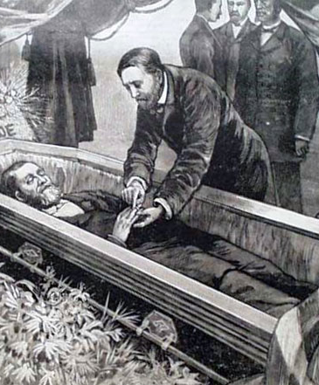
The Lehigh Valley Response
William Harrison H. Haus of Bethlehem, PA (1841-1861)
William Harrison Haus was also among the first men to volunteer for service with Company A of the 1st Regiment of Pennsylvania Volunteers at the start of the war in April of 1861.
He was also Bethlehem’s first casualty. William died not from battle, but rather from a fever. His body was returned to Bethlehem on July 25, 1861.
Several thousand people are reported to have attended his funeral.
Death from disease and illness, such as the case with William, was sadly not a rare occurrence during the Civil War, and it was in fact the cause of one half of all deaths.
Notes:
For further reading see:
Levering, J. M. 1903. A History of Bethlehem, Pennsylvania, 1741-1892 : With Some Account of Its Founders and Their Early Activity in America. Genealogy & Local History. Bethlehem, Pa.: Times Pub. https://ia600304.us.archive.org/23/items/historybethlehem00leve/historybethlehem00leve.pdf
Image is a depiction of the funeral for General Ulysses S. Grant, printed in a newspaper, 1885.

Slide 4
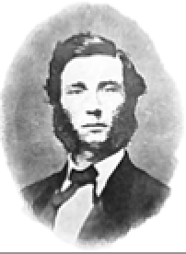
The Lehigh Valley Response
Captain Jonathan K. Taylor of Bethlehem, PA (1842 - 1863)
Along with Fredrick Frueauff and William Haus, Jonathan was also among the first young men to enlisted with Co. A of the 1st PA Volunteers in April of 1861.
He was only 18 years old and a student at the time. He enlisted for 3 months as a private, and like many others, likely thought the war would be over quickly.
Jonathan, soon after, saw fighting at the Battle of Bull Run in July of 1861.
Later, he re-enlisted with Company C of the 129th Regiment on Aug. 8, 1962, but this time as a Captain.
During the Battle for Fredericksburg, VA – one of the bloodiest battles of the war - he was shot through the shoulder and the lung on December 12, 1862.
After a long battle with with his wounds, Jonathan died 105 days later at the young age of 20.
Jonathan Taylor was the only officer from Bethlehem to die from wounds suffered in battle and in 1887, a monument was installed in the Bethlehem Rose Garden to honor him and all of Bethlehem’s Civil War Veterans.
Notes:
For further reading see:
Whelan, Frank. ”History’s Headlines: Captain Jonathan Taylor of Bethlehem.” WFMZ, October 22, 2022. https://www.wfmz.com/features/historys-headlines/historys-headlines-jonathan-taylor-of-bethlehem/article_697f7f3c-4fd6-11ed-9c27-cf5c502756c0.html
CWRT of Eastern PA. “Bring Home Jonathan K. Taylor’s Sword.” CWRT of Eastern PA, May 4, 2023. Accessed: May 10, 2023. http://www.cwrteasternpa.org/brigade-news/2023/5/4/bring-home-jonathan-k-taylors-sword

Slide 5
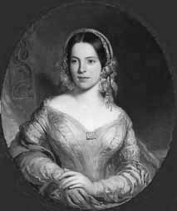
The Lehigh Valley Response
Elizabeth Embich Shindel Hutter (1821-1895)
Elizabeth was born in Lebanon, PA, and attended the Moravian Seminary for Young Ladies in Bethlehem during the 1830s.
After the tragic deaths of her two young sons due to Scarlet Fever, Elizabeth and her husband Edwin Hutter dedicated their lives to benevolent work. In 1853 Elizabeth helped found the Northern Home for Friendless Children, a residential facility in Philadelphia for destitute children, which still exists today as the “Northern Children’s Services” and serves over 3,000 children and their families each year. She also worked as a fundraiser for The Great Sanitary Fair in Philadelphia in 1861 and is credited with raising $250k.
During the Civil War, Mrs. Hutter served as a volunteer nurse at local hospitals, and on July 4, 1863, she was granted a Presidential pass by Abraham Lincoln to travel to Gettysburg and be the first person to cross the battle lines after the fight. She attended to both wounded Union and Confederate soldiers.
Her firsthand knowledge of the suffering caused by war led her to spearhead a fundraising campaign to build the Philadelphia Soldiers’ and Sailors’ Orphans Institute in 1865, which provided shelter and education to war orphans. She also met with President Lincoln to discuss the establishment of such institutions in every state.
In 1866, Elizabeth was appointed “Lady Inspector of the Department of Soldiers’ Orphans,” making her the first woman in the history of the commonwealth of PA to be granted a Governor’s Commission.
Notes:
For further reading see:
Find A Grave. “Elizabeth Embich Shindel Hutter,” Find A Grave. Accessed: August 30, 2023. https://www.findagrave.com/memorial/20490948/elizabeth-embich-hutter.

Slide 6
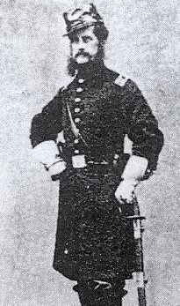
The Lehigh Valley Response
Captain Owen Rice of Nazareth, PA
(1836 - 1892)
Owen Rice was educated at Nazareth Hall and Moravian Theological Seminary before becoming a Teacher at Nazareth Hall, which became a military academy for youths during the war in 1863.
Owen enlisted on October 8, 1862, as a Captain when he was 26 years old.
He served as Captain of Company A, 153rd Regiment, PA Volunteer Infantry (1861-1863).
His Company fought at the Battle of Fredericksburg in December of 1862 and the Battle of Chancellorsville in May of 1863, where he suffered a bullet wound in his arm, but avoided amputation. This wound would prevent him from joining his men at the Battle of Gettysburg, and he was mustered out on July 24, 1863 after 10 months of service, which including combat in two of the war’s fiercest campaigns.
Later Owen served in the U.S. House of Representatives from 1864-1865.
Notes:
For further reading see:
Weaver, Ethan Allen. 1911. Owen Rice, Christian, Scholar and Patriot : A Genealogical, Biographical and Historical Memoir. Germantown, Pa.: Priv. Print. by E.A. Weaver. – Available at Reeves Library and online through the Internet Archive (https://archive.org/details/owenricechristia00weav).

Slide 7
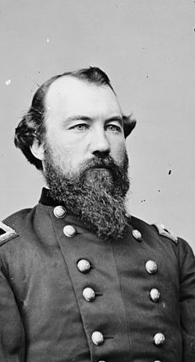
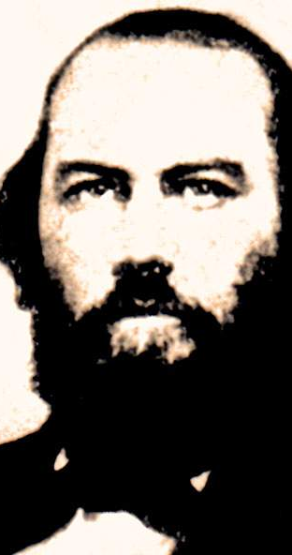
The Lehigh Valley Response
McIntosh Brothers
Brother Vs. Brother
John Baillie McIntosh (1829-1888) and
James McQueen McIntosh (1828-1862)
Both John and James were born in Tampa, Florida and educated at the Moravian Academy in Nazareth, PA.
They came from a long ling of military men. Their grandfather was a Commander in the Continental Congress, their father was a Colonel in the Army, and their great-great Uncle was a General.
When southern states began seceding in early 1861, James, who had been serving in the Union Army in Arkansas, resigned his commission and joined the Confederate army, rising to the rank of Brigadier General.
His brother John on the other hand, who had also been in the service, stayed with the Union Army and ultimately rose to the rank of Major General.
Both brothers would rise to the rank of General fighting for opposite sides of the war. James McIntosh though, was killed in action during the Battle of Pea Ridge in Arkansas, while John lost a leg, but survived and retired from the army in 1870.
Notes:
For further reading see:
“John Baillie McIntosh,” Find A Grave. Accessed: August 1, 2023. https://www.findagrave.com/memorial/4904/john-baillie-mcintosh.
Dickinson College. “John Baillie McIntosh (American National Biography).” House Divided: Civil War Research Engine. Accessed: August 1, 2023. https://hd.housedivided.dickinson.edu/node/17929.
Dickinson College. “James McQueen McIntosh (American National Biography).” House Divided: Civil War Research Engine. Accessed: August 1, 2023.
“James McQueen McIntosh.” El Paso Museum of History. Accessed: August 1, 2023. https://www.digie.org/en/media/71851.
Images
“Gen. John B. McIntosh, U.S.A.” Library of Congress, https://www.loc.gov/pictures/item/2018667232/.
"James McQueen McIntosh," House Divided: The Civil War Research Engine at Dickinson College, https://hd.housedivided.dickinson.edu/node/37581.

Slide 8
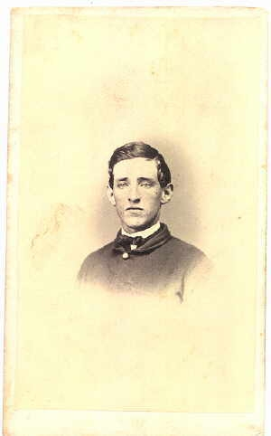
The Lehigh Valley Response
William David Luckenbach of Bethlehem, PA (1840-1915)
William was a student at Dickenson College when he enlisted on May 16, 1861, with Company C of the 5th NY Infantry for three month at the age of 20.
He later re-enlisted on August 12, 1862, for nine more months with Company C of the 129th PA Infantry.
During his second mustering, William fought at the Battle of Antietam on September 17 of 1862.
The Battle of Antietam was the deadliest single day of battle, with both sides suffering more than 22,000 deaths, and neither side could claim a decisive victory. William Survived this battle and mustered out of the army on May 18, 1863, and would go on to have a successful career as an attorney and judge.
Notes:
For further reading see:
Myers, Richmond E. 1963. “The Moravian Church and The Civil War,” Transactions of the Moravian Historical Society. Vol. 19, Nazareth, PA: Moravian Historical Society.
*Image shown is a creative commons photo of an unnamed soldier.

Slide 9
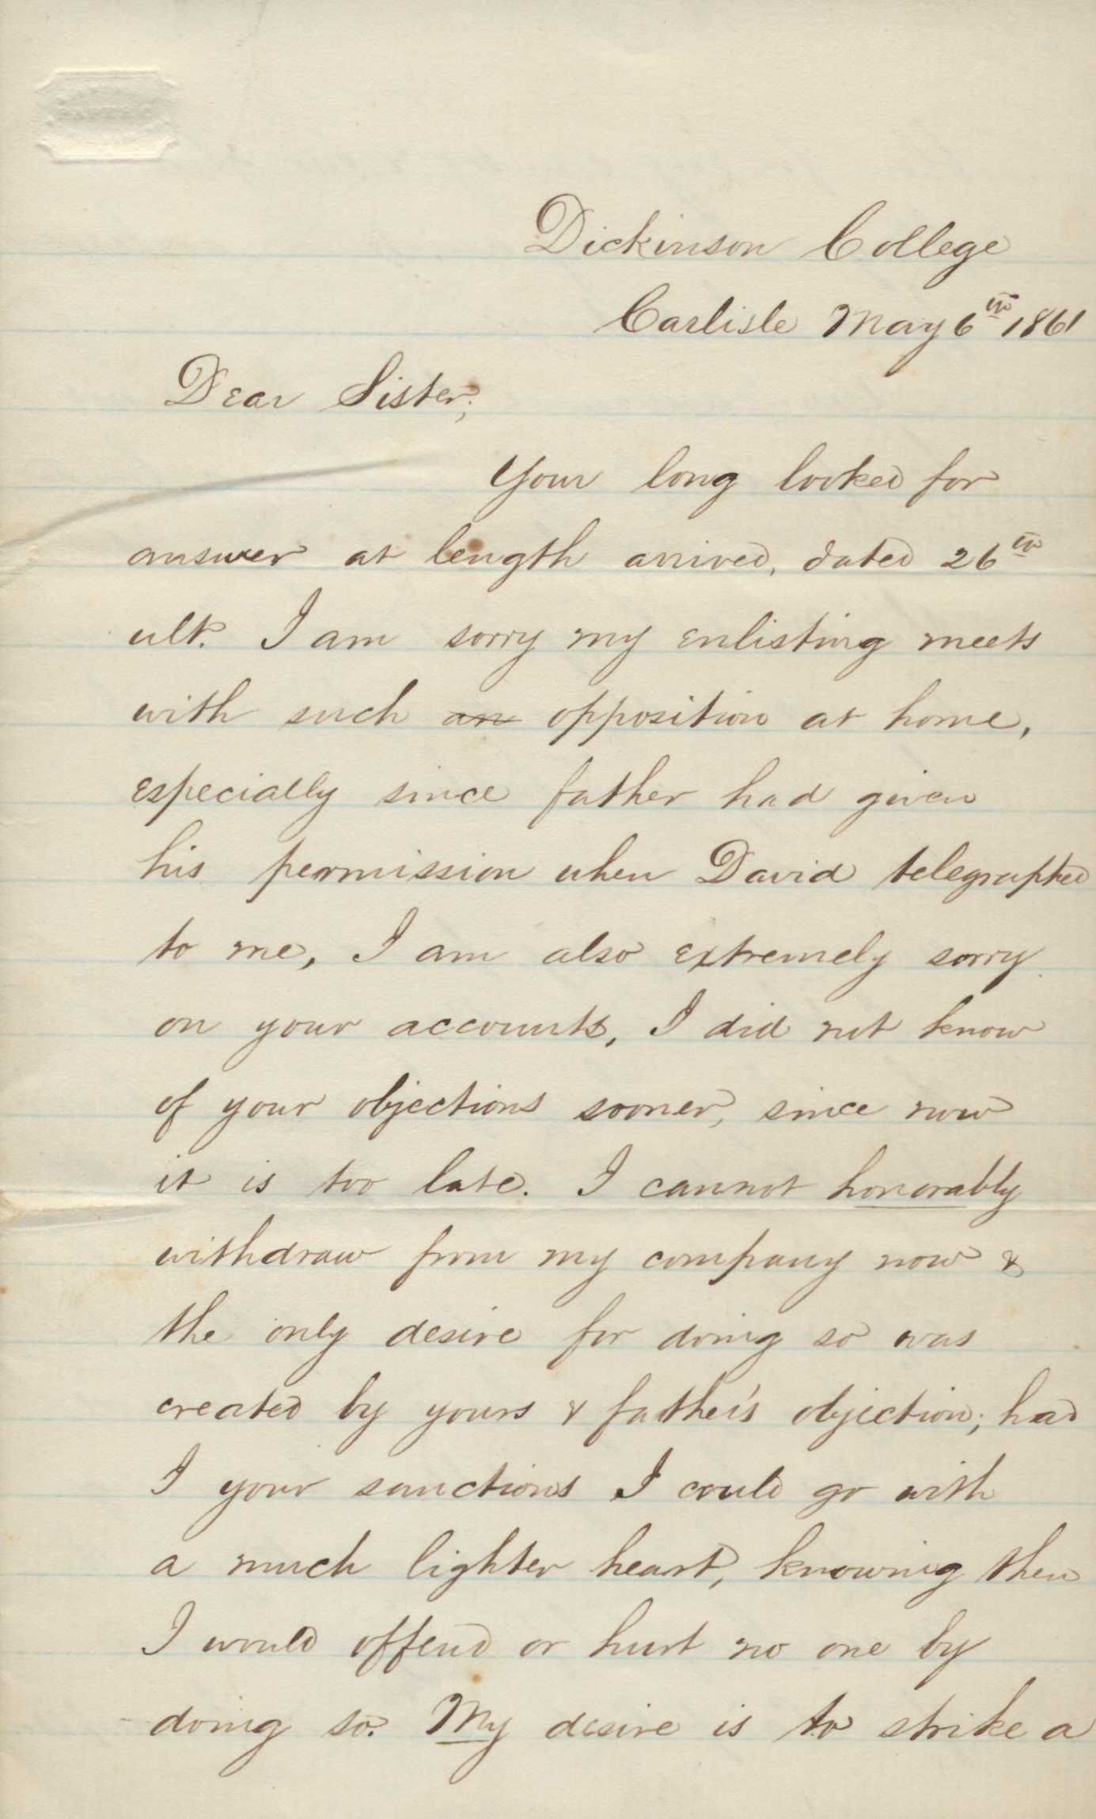
The Lehigh Valley Response
William D. Luckenback Letter to his sister:
Dear Sister
Your long looked for answer at length arrived. I am sorry my enlisting meets with such opposition at home, especially since Father gave his permission when David telegraphed to me. I am also extremely sorry on your account that I did not know of your objection sooner, for now is too late. I cannot honorably withdraw from my company now and the only the only desire for so doing was created by your objection. Had I your sanction I could go with a lighter heart, knowing that I would offend or hurt no one by so doing. My desire is to strike a blow for my country and our glorious flag.
Your assurance that I need not be afraid of anyone having branded me a coward for not going with the Washington Grays* is indeed well meant but not soothing enough since I know my own brother-in-law had branded me as such, as well as some of my friends.
Sister, you certainly would not wish me to be considered a coward by the Fencibles* too! I know you would not like to have your brother branded a coward. There is no one more willing to lend his feeble assistance to his government than I, and if I must fall, I can not do so in a more just cause and though depraved of a brother you would have the consolidation to know he had done his duty as an American citizen. But let not such gloomy thoughts posses your mind. If called out, we will probably have very little fighting to do being most likely to be stationed along the line to keep the Marylanders in order.
(*”The Washington Grays” was a local militia made up of volunteers, formed to protect the Bethlehem area.
**The Carlisle Fencibles was the nick-name for Company A, 7th Regiment.)
Notes:
Discussion:
Why do you you think William Luckenbach enlisted in the Army? What do you think his expectations for service in the army were?
Source: Faculty Collection A10, Folder: “Richmond E. Myers – Civil War Letters,” Moravian University Archives, Reeves Library, Bethlehem, PA.

Slide 10
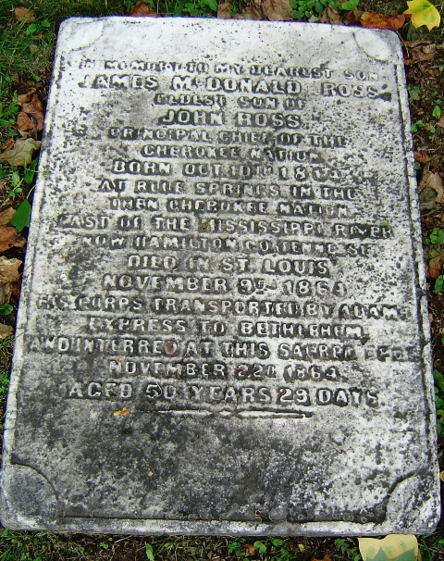
The Lehigh Valley Response
James McDonald Ross of Blue Springs, Cherokee Nation (1814-1864)
James was the eldest son of Chief John Ross of the Cherokee Nation who had very close ties with the Moravian Church and Bethlehem.
While James’ father, Chief Ross, was opposed to the war and urged members of his tribe to not get involved, James very strongly sympathized with the plight of African Americans in the south and so he joined one of the Union Army’s three “Indian Regiments” to fight against slavery in 1862.
In April of 1863, James was captured by the Confederacy while on his way to Fort Gibson. James died on November 9, 1864, in St. Louis while a prisoner of war.
Afterwards, his father arranged for his body to be transported to Bethlehem where he was buried in Nisky Hill Cemetery.
Notes:
For further reading see:
”James McDonald Ross.” Find a Grave. Accessed: August 1, 2023. https://www.findagrave.com/memorial/46212077/james-mcdonald-ross.
Hargett, J. L.. Obituary of James McDonald Ross. 4026.8441-.4. John Ross Papers. November 9, 1864. Tulsa: Gilcrease Museum, https://collections.gilcrease.org/object/40268441-4 (03/01/2018).
“Forgotten Warriors: American Indian Home Guard.” National Park Service. https://www.nps.gov/articles/aihomeguard.htm

Slide 11
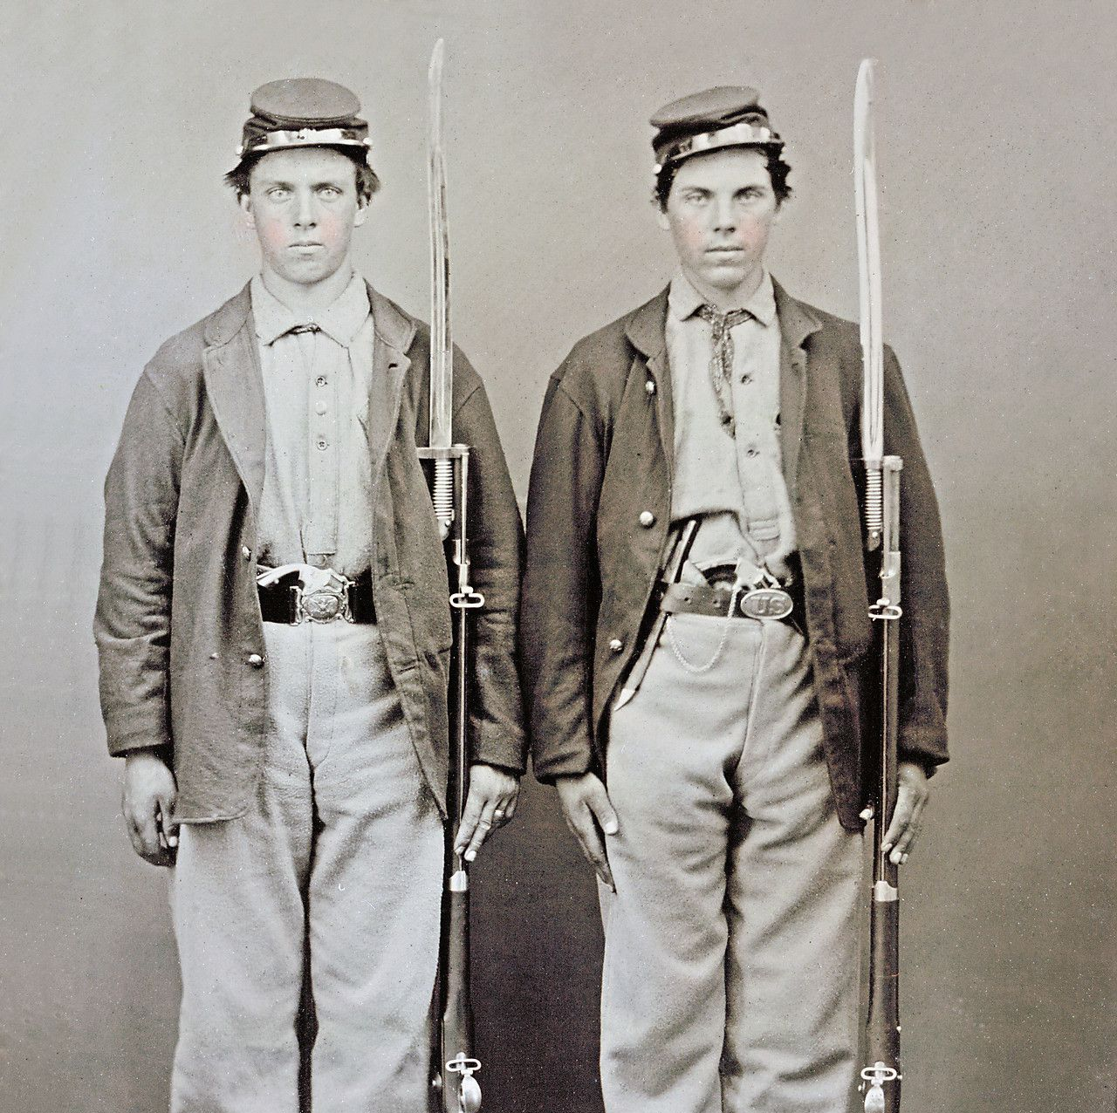
The Lehigh Valley Response
The Fickardt Brothers:
Frederick Jr. and Augustus
When Confederate Army General, Robert E. Lee and his men invaded Pennsylvania in the Summer of 1863, Bethlehem Doctor, Fredrick Fickardt gave a passionate speech to a large crowd in front of the Eagle Hotel (now Hotel Bethlehem) encouraging young men to join the Union Army.
Forty men from Bethlehem would enlist that day, including Dr. Fickardt’s two sons, Frederick Jr. (age 20) and Augustus Fickardt (age 18).
Both sons died shortly after, only five days apart from each other, and both from Typhoid.
Notes:
For further reading see:
Levering, J. M. 1903. A History of Bethlehem, Pennsylvania, 1741-1892 : With Some Account of Its Founders and Their Early Activity in America. Genealogy & Local History. Bethlehem, Pa.: Times Pub. https://ia600304.us.archive.org/23/items/historybethlehem00leve/historybethlehem00leve.pdf
Image shown is a creative commons photo of unnamed soldiers.

Slide 12
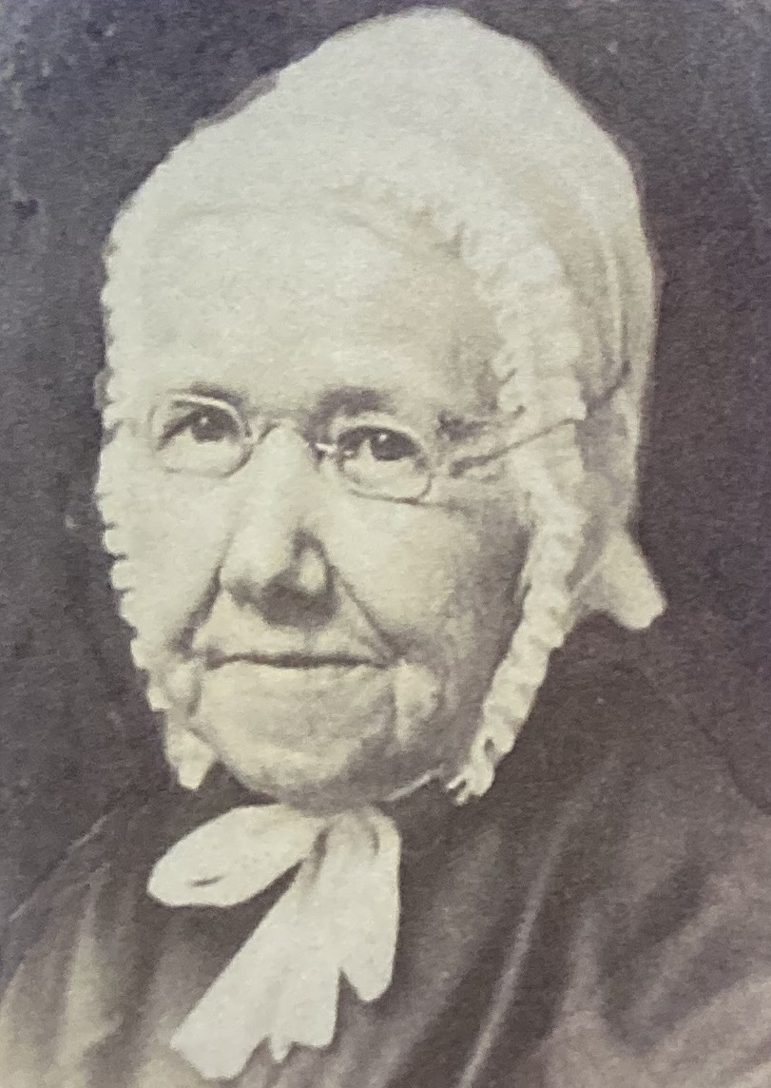
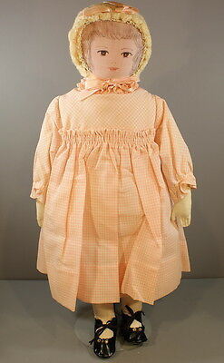
The Lehigh Valley Response
Johanna Maria “Polly” Heckewelder
In 1861, Poly Heckewelder founded the Soldiers’ Relief Society in Bethlehem, which sewed clothing and other items for the Union Soldiers fighting in the Civil War.
When the society began sewing cloth dolls for charity in 1872, the society decided to honor the group’s founder by naming the dolls “Polly”.
Today the “Polly Heckewelder Doll” is the oldest continuously produced doll in the world, with new dolls being hand made to this day by members of the Bethlehem Sewing Society.

