Slide 1
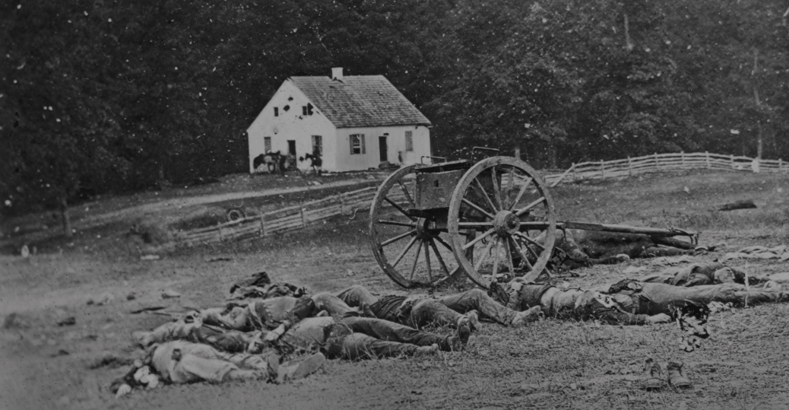
Civil War Calling: The Lehigh Valley Response Life and Death
Notes:
A presentation compiled by Justin T. Weiksner, Moravian University, Class of 2024

Slide 2
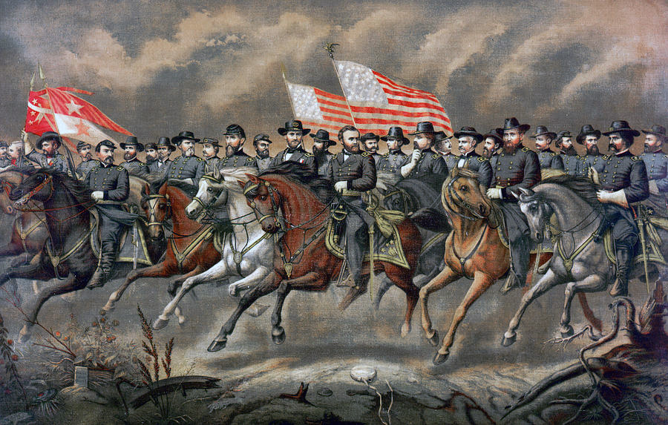
Life and Death
Notes:
When presenting, some variant of the following monologue may be helpful: “More Americans (soldiers and civilians alike) were killed during the Civil War than in any other conflict the US has fought in. Even if we were to only consider Union deaths, the only conflict that surpasses it is the Second World War. And when one thinks of the Civil War, images of glorious and terrible battles come to mind, of bravery and heroism through fire and war.”

Slide 3
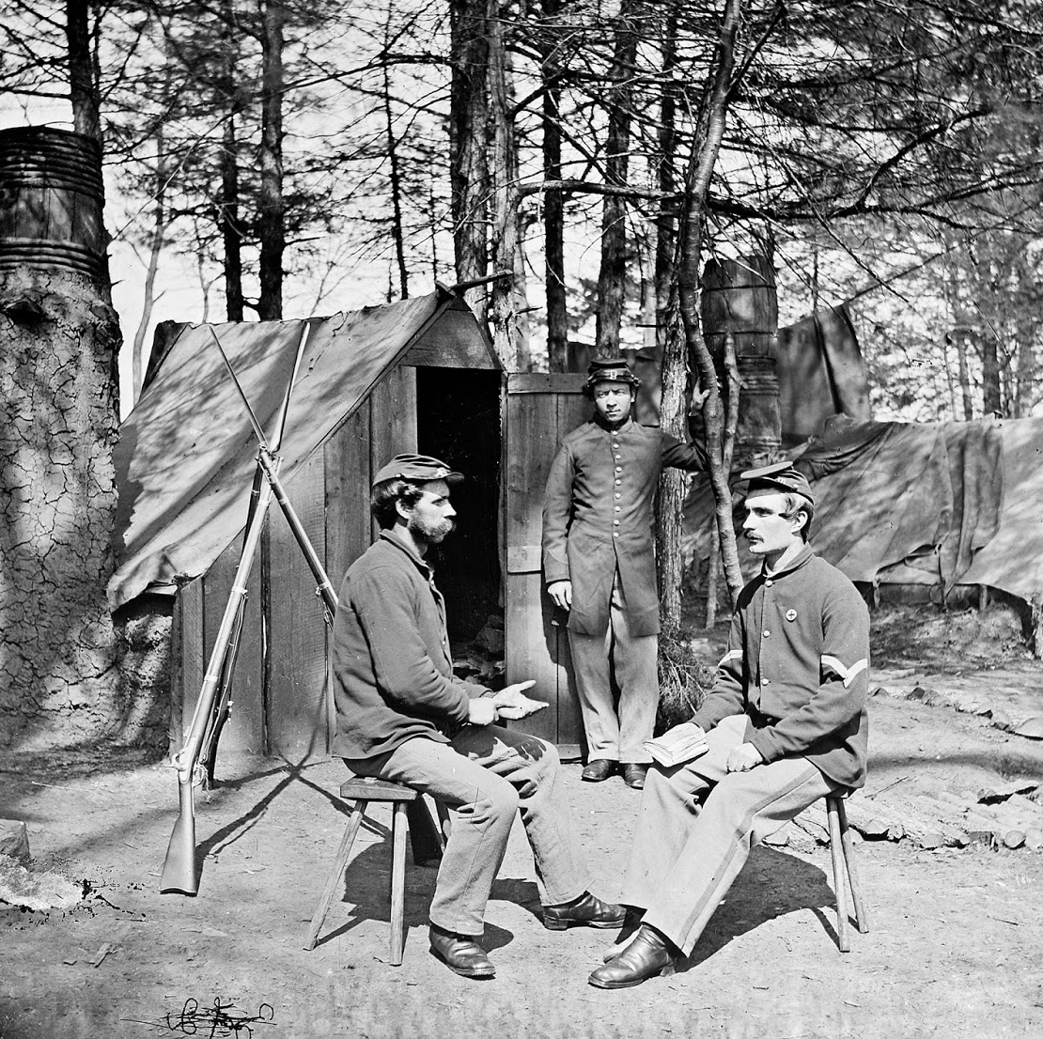
Daily Life as a Soldier
What was it like outside of combat?
Much of the civil war wasn’t on the battlefield, but off: total war- such as Sherman’s March to the Sea- was seldom seen. During the winter especially, soldiers would wait it out until they could get on the march again in spring.
Soldiers tried to keep themselves occupied best they could, since there were only so many drills which could be done and tasks needed to maintain camp.
The biggest issues aside from boredom were food and disease. The Union could get rations to their troops better than the Confederacy could, but neither side’s rations were appetizing.

Slide 4
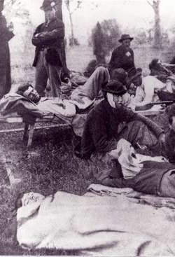
Hygiene and Disease
Today, we take for granted a certain measure of sanitation. But in the 1860s, cleanliness could mean the difference between life and a grueling, painful death.
Camps often lacked clean water and sanitation facilities, causing outbreaks of dysentery, typhoid, and smallpox. Half of those who perished died not on the battlefield but from disease.
Germ theory was in its infancy, and while anesthetics existed, availability and dosage varied wildly, especially in battlefield hospitals. No antibiotics meant that even when a wounded limb would be amputated to prevent infection, there was still a good chance the site of amputation would itself get infected.

Slide 5
Medical Care and Hospitals
The rigors of war necessitated specialized care
The most common type of hospital was anything but, being a collection of tents near the front, packed with soldiers and seriously overworked doctors and nurses.
Union hospitals in the American Civil War evolved over time, becoming more organized and efficient. They were set up in churches, homes, and tents, using the Sanitary Commission's guidelines to improve sanitation and care.
Despite advancements, challenges like overcrowding and limited supplies persisted, but survival rates improved compared to the war's onset.

Slide 6
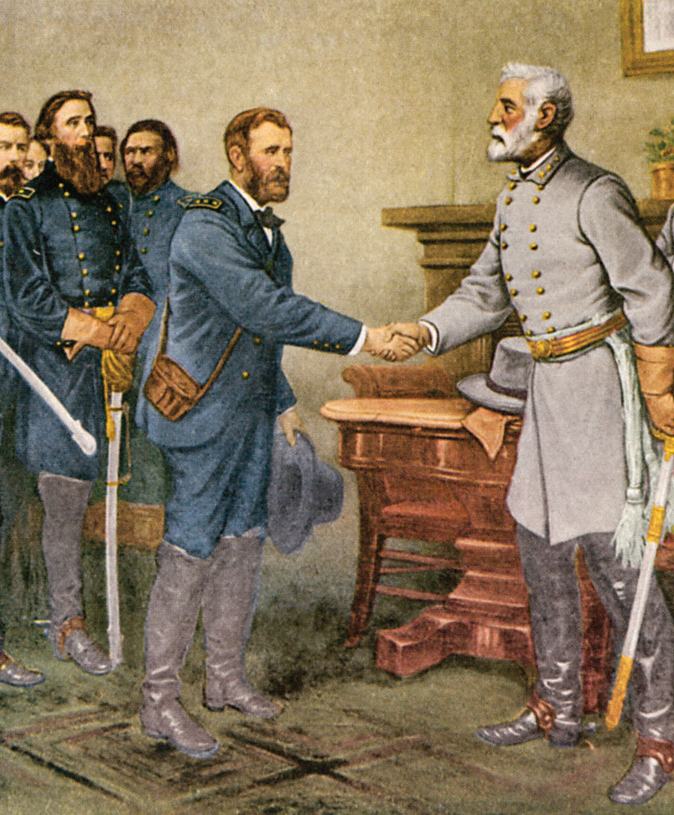
Aftermath, the Numbers
The War is over! Now what?
Estimates for the number of lost lives range from over 600 thousand to over a million (if you consider civilians and the enslaved).
Most were Union, with over 365 thousand dead on a low estimate. The Confederacy lost over 290 thousand of its soldiers.

Slide 7
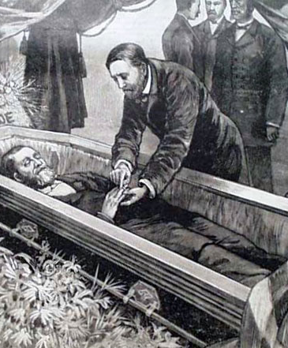
The Dead
William Harrison H. Haus of Bethlehem, PA (1841-1861)
William Harrison Haus was also among the first men to volunteer for service with Company A of the 1st Regiment of Pennsylvania Volunteers at the start of the war in April of 1861.
He was also Bethlehem’s first casualty. William died not from battle, but rather from a fever. His body was returned to Bethlehem on July 25, 1861.
Several thousand people are reported to have attended his funeral.

Slide 8
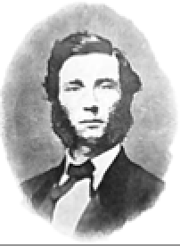
The Dead
Captain Jonathan K. Taylor of Bethlehem, PA (1842 - 1863)
Along with Fredrick Frueauff and William Haus, Jonathan was also among the first young men to enlisted with Co. A of the 1st PA Volunteers in April of 1861.
He was only 18 years old and a student at the time. He enlisted for 3 months as a private, and like many others, likely thought the war would be over quickly.
Jonathan, soon after, saw fighting at the Battle of Bull Run in July of 1861.
Later, he re-enlisted with Company C of the 129th Regiment on Aug. 8, 1962, but this time as a Captain.
During the Battle for Fredericksburg, VA – one of the bloodiest battles of the war - he was shot through the shoulder and the lung on December 12, 1862.
After a long battle with with his wounds, Jonathan died 105 days later at the young age of 20.
Jonathan Taylor was the only officer from Bethlehem to die from wounds suffered in battle and in 1887, a monument was installed in the Bethlehem Rose Garden to honor him and all of Bethlehem’s Civil War Veterans.

Slide 9
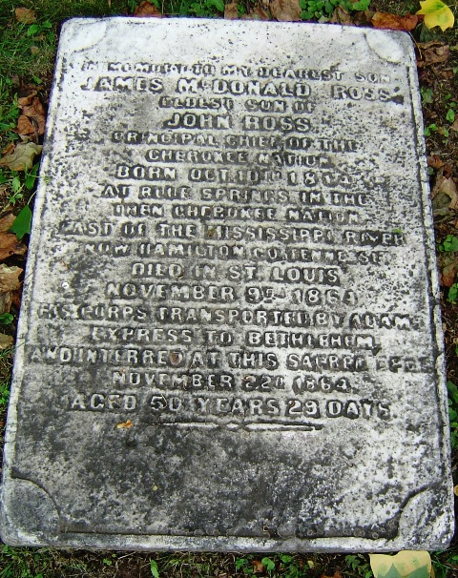
The Dead
James McDonald Ross of Blue Springs, Cherokee Nation (1814-1864)
James was the eldest son of Chief John Ross of the Cherokee Nation who had very close ties with the Moravian Church and Bethlehem.
While James’ father, Chief Ross, was opposed to the war and urged members of his tribe to not get involved, James very strongly sympathized with the plight of African Americans in the south and so he joined one of the Union Army’s three “Indian Regiments” to fight against slavery in 1862.
In April of 1863, James was captured by the Confederacy while on his way to Fort Gibson. James died on November 9, 1864, in St. Louis while a prisoner of war.
Afterwards, his father arranged for his body to be transported to Bethlehem where he was buried in Nisky Hill Cemetery.

Slide 10
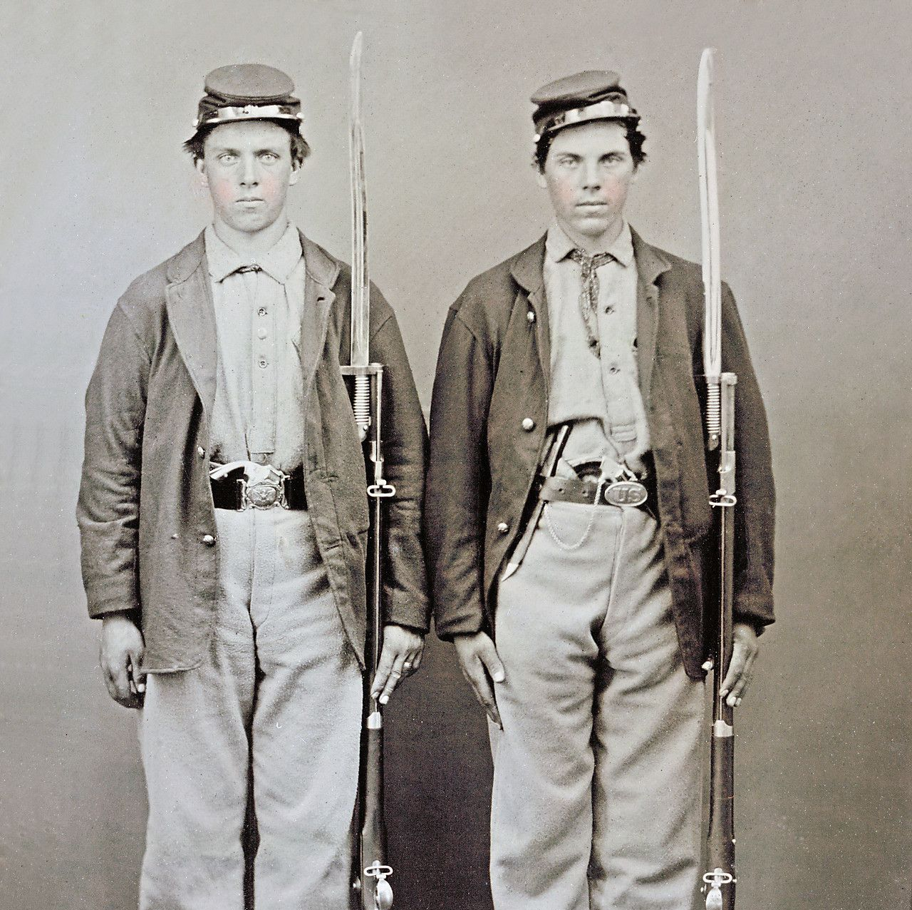
The Dead
The Fickardt Brothers:
Frederick Jr. and Augustus
When Confederate Army General, Robert E. Lee and his men invaded Pennsylvania in the Summer of 1863, Bethlehem Doctor, Fredrick Fickardt gave a passionate speech to a large crowd in front of the Eagle Hotel (now Hotel Bethlehem) encouraging young men to join the Union Army.
Forty men from Bethlehem would enlist that day, including Dr. Fickardt’s two sons, Frederick Jr. (age 20) and Augustus Fickardt (age 18).
Both sons died shortly after, only five days apart from each other, and both from Typhoid.

Slide 11
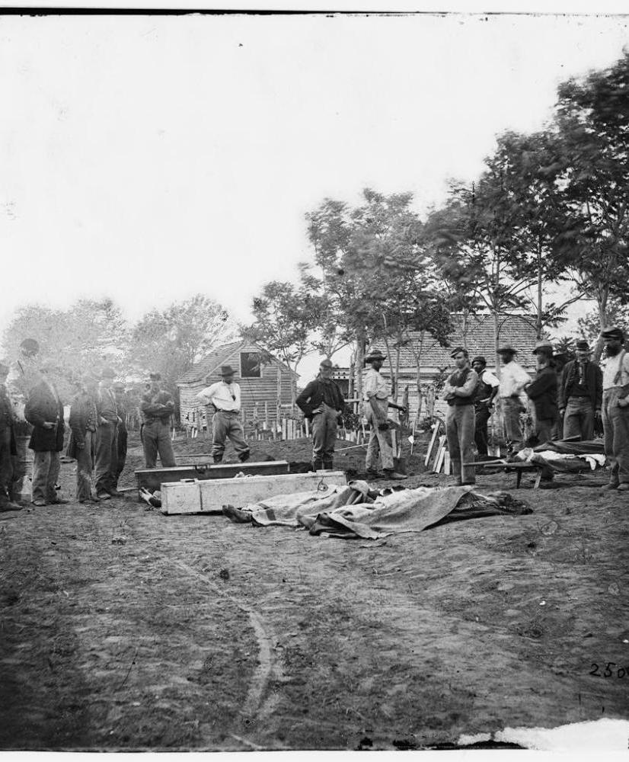
Remembering the Dead, Funerals
The War is over! Now what?
Initially, burials were hasty due to battlefield conditions, but post-war, efforts were made to properly honor fallen soldiers.
National cemeteries were established, where formal ceremonies commemorated the war dead’s sacrifice, fostering national healing.
The practice of embalming (preserving) a dead body took off in American culture following the assassination of Lincoln and the very public display of his corpse.

Slide 12
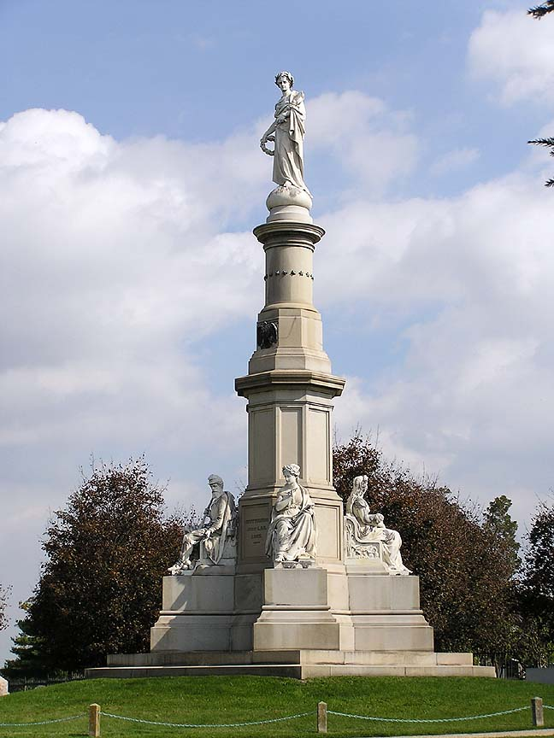
Remembering the Dead, Memorials
The War is over! Now what?
To honor and remember comrades and loved ones who died in the Civil War, veterans and communities erected memorials across the country.
These monuments served as focal points for remembrance and reflection on the sacrifices made.
In the case of explicitly Southern memorials, however, many were erected in the early and mid 20th century to perpetuate the Lost Cause myth.

Slide 13
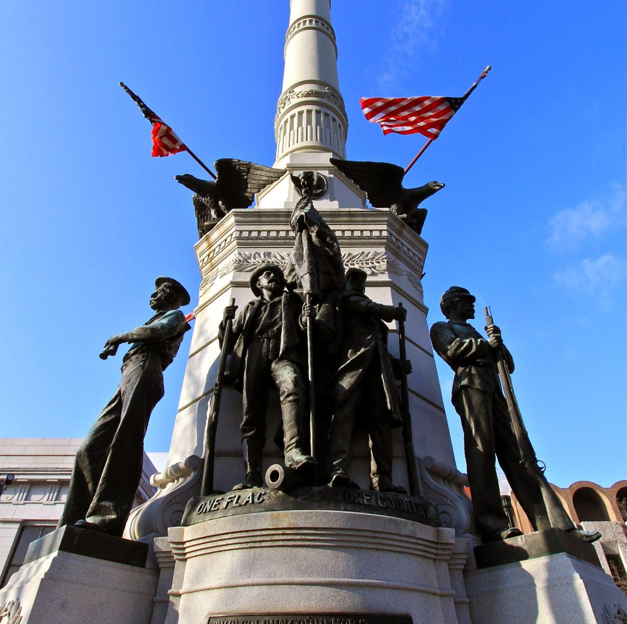
The Lehigh Valley Response
Soldiers and Sailors Monument, Allentown
The monument was dedicated in 1899, and was rededicated in the 1960s.
It’s unusual (and infamous) among Pennsylvanian Civil War memorials in that its message emphasizes the reconciliatory “one country under one flag” sentiments of the era, and as such features a Confederate soldier alongside a Union one despite Pennsylvania being a Union state.

Slide 14
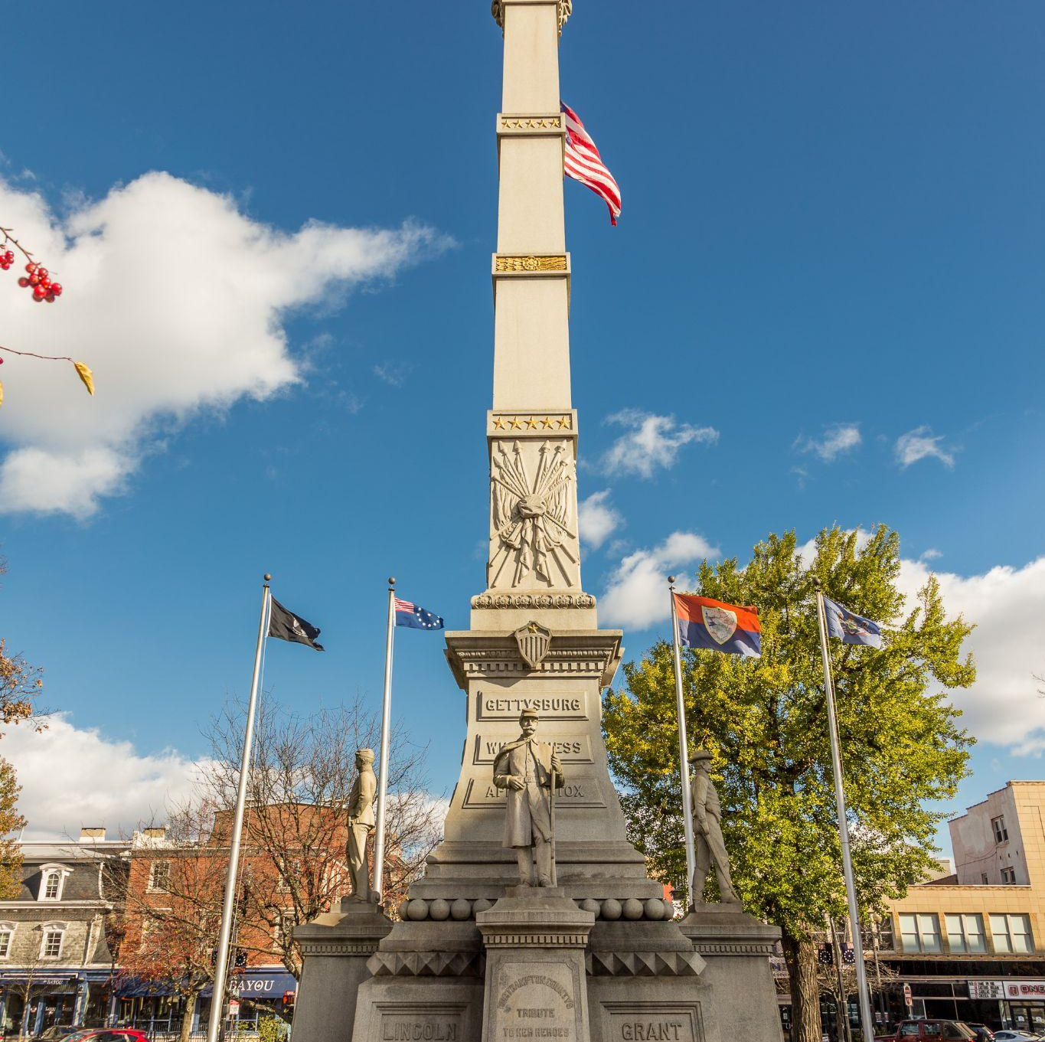
The Lehigh Valley Response
Soldiers and Sailors Monument, Easton
The monument was dedicated in 1900 and consists of a 75 foot tall pillar surrounded by four soldiers representing the branches of the military at the time: infantry, artillery, cavalry, and navy.
After Thanksgiving, the monument is transformed into the Peace Candle.

Slide 15
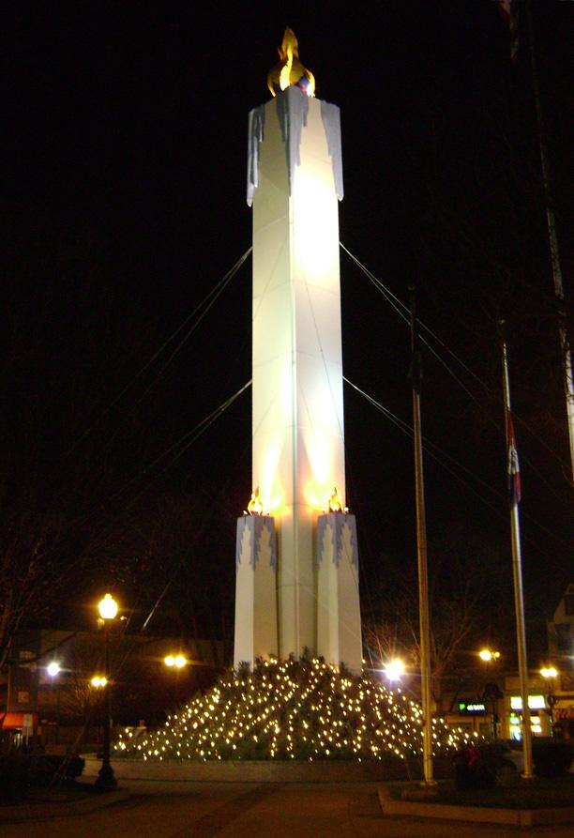
The Lehigh Valley Response
Peace Candle, Easton
Pictured is the Peace Candle, built over the monument every December to celebrate the season.
Notably, during the Vietnam War, it served as the site of anti-war protests.
Some people have called it tacky, disrespectful to veterans, and so forth. Despite this, polling has shown most residents don’t mind it.

Slide 16
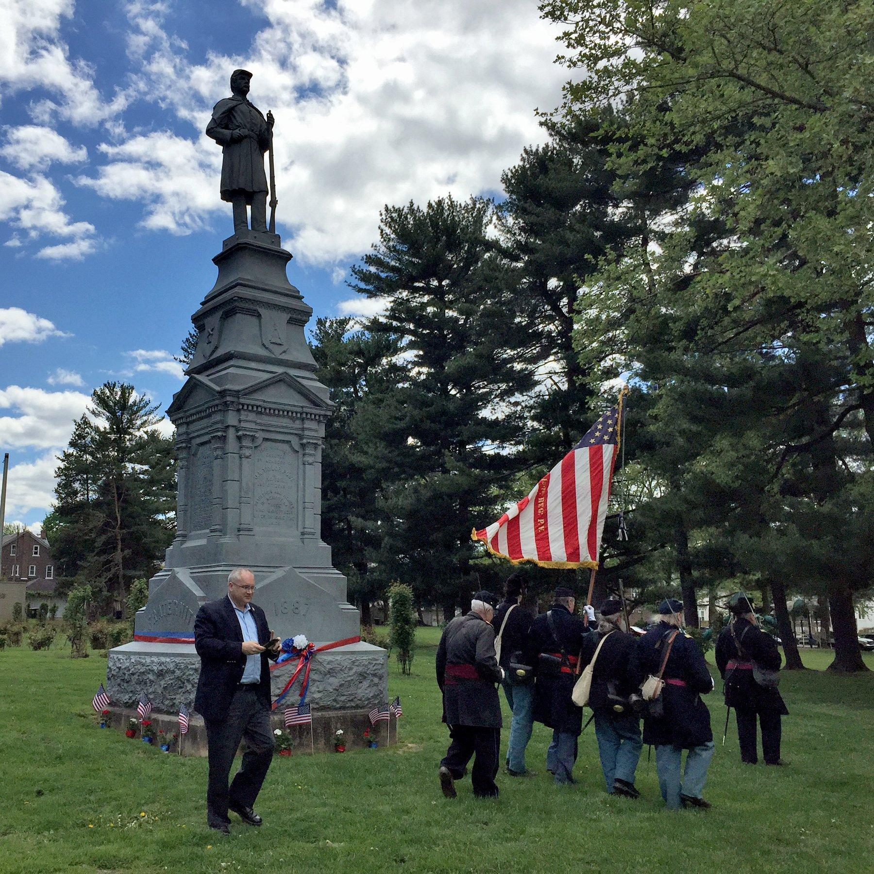
The Lehigh Valley Response
Rose Garden Monument, Bethlehem
The monument in Rose Garden park is dedicated to the aforementioned Capt. Taylor.
It was originally dedicated in 1887, and was briefly taken down in 2015 for repairs, and because it was leaning.

Slide 17
Those Who Remain
The War is over! Now what?
The war ripped families apart. Parents lost their sons, children lost their fathers, wives lost their husbands.
The Civil War left thousands of children orphaned, prompting the creation of orphanages to care for those who lost their parents. These institutions aimed to offer shelter, education, and a chance for a stable life amidst the post-war societal upheaval.
The U.S. Government implemented pension programs for veterans or their widows.

Slide 18
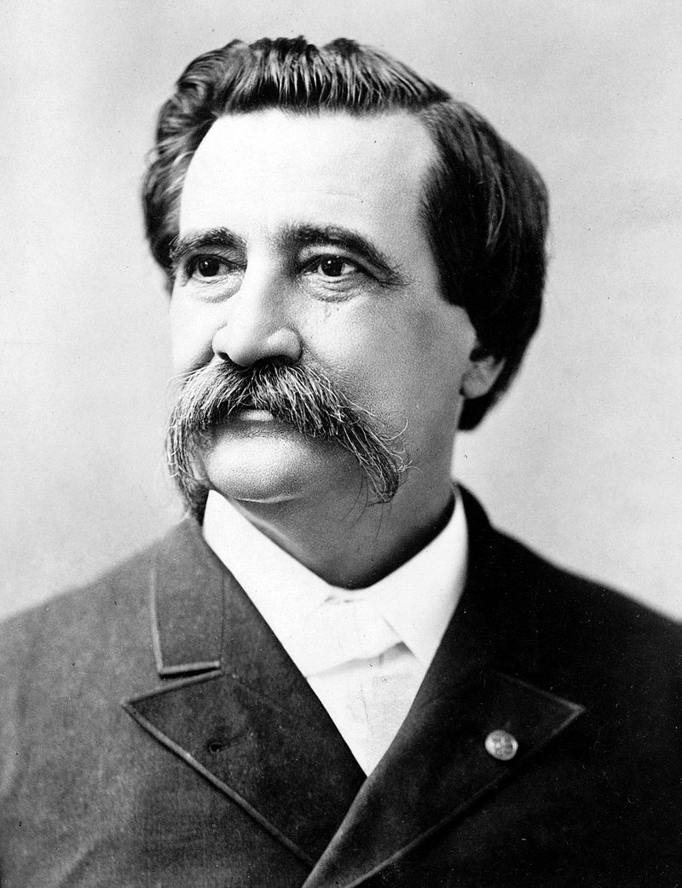
Memorial Day
The War is over! Now what?
Originally celebrated as Decoration Day on May 30, 1868, it was promoted by General John A. Logan (right), leader of the GAR (“The Grand Army of the Republic”, a society of Union veterans), to adorn the graves of fallen soldiers with flowers.
Over time, the Northern states would standardize their celebrations, and by the dawn of the 20th century it was celebrated across the North as state holidays.
Federal adoption, however, would prove a challenge because Southern states had their own, parallel holidays to remember their dead, and Memorial Day would only become a federal holiday in 1971.

