Slide 1
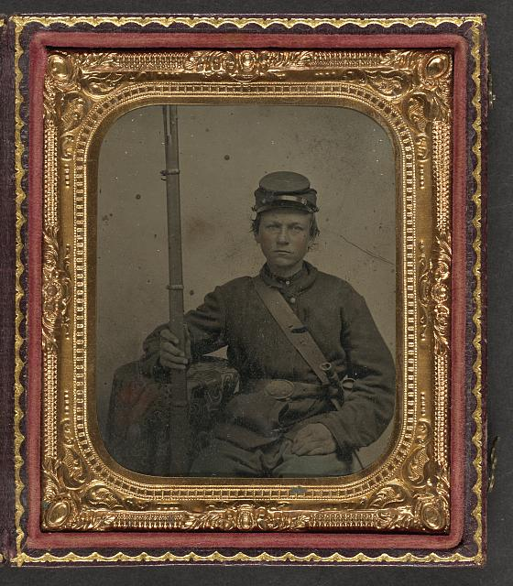
Civil War Calling:
The Lehigh Valley
Response
What They Carried
Notes:
This presentation is inspired by the American Battlefield Trust’s “Life at War” presentation and is intended to be shown with the replica uniform and backpack, available to Lehigh Valley educators through Reeves Library of Moravian University. We also highly recommend viewing the ABT’s “What they carried” video at https://www.battlefields.org/learn/videos/equipment-civil-war.
Image: Unidentified young soldier in Union uniform with musket and bayonet in scabbard. United States, None. [Between 1861 and 1865] Photograph. https://www.loc.gov/item/2010648889/.
Image is marked with Public Domain Mark 1.0. To view the terms, visit https://creativecommons.org/publicdomain/mark/1.0/?

Slide 2
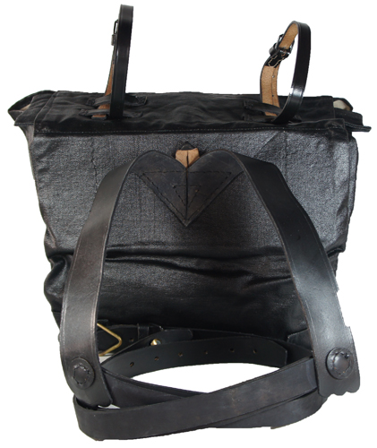
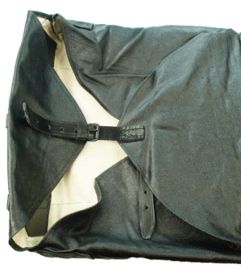
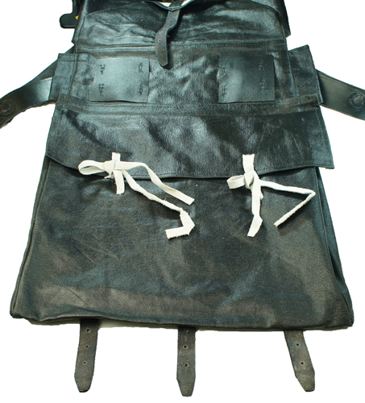
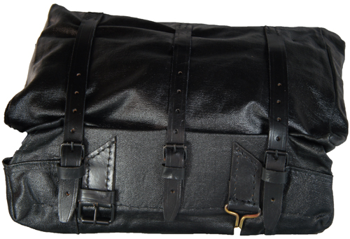
What They Carried
Leather Knapsack covered with tar (shown from different angles)
Why do you think bags were covered with tar?
Notes:
This knapsack is designed with two compartments for storage. One bag closes with white leather ties, the other with leather straps and buckles. There are blanket roll straps on top for carrying a blanket or greatcoat. The back straps have scalloped ends and the brass buttons are covered with leather circles. Leather chest cross straps are attached with J-hooks on the ends which are designed to attach to the waist belt to provide extra support. The knapsack is made from canvas that has been tar painted, similar to the originals, for waterproofing.

Slide 3
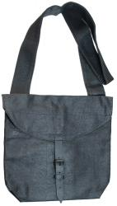
What They Carried
Haversack
Coated with tar to protect contents from moisture.
How heavy do you think the knapsack and haversack would have been to carry when filled with supplies?
Notes:
The haversack was an integral part of a Civil War soldier's equipment, providing them with a means to carry essential items and personal belongings. During the Civil War, there were two main types of haversacks in use: tarred and un-tarred. Tarred haversacks were military-issued and made from a muslin-like material. The exterior of these haversacks was coated with black tar to protect the contents from moisture. On the other hand, un-tarred haversacks were used by soldiers who supplied their own uniforms and equipment. These haversacks were constructed from a heavier muslin or cotton material, which provided durability to withstand the harsh outdoor conditions and the demands of a soldier's daily routine. Both types of haversacks served the purpose of carrying essential items such as food, ammunition, utensils, and personal items that soldiers brought from home.

Slide 4
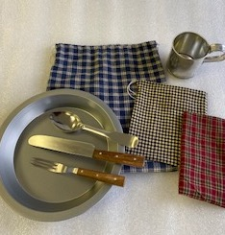
What They Carried
Eating Utensils and Storage Bags
1 plate and set of utensils
1 cup
And storage bag for keeping materials clean
Notes:
Silverware
Plate & Cup (Tin)
Small cloth sacks for storing eating utensils and crockery

Slide 5
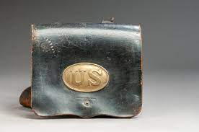
What They Carried
Leather Cartridge Box, which stored ammunition for their rifle.
Notes:
The cartridge box was worn on the soldier’s belt. Inside usually, was a tin liner where they kept their cartridges—paper tubes filled with Minnie balls (bullets) and black powder. Union Soldiers cartridge boxes typically carried forty rounds of ammunition. Extra cartridges that did not fit into the cartridge box were carried in pockets or a knapsack.

Slide 6
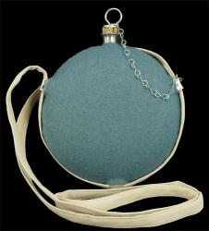
What They Carried
Canteen with sky blue protective wool cover
Notes:
This Canteen is made of stainless steel but has a sky-blue wool cover that was hand-stitched. Canteens were covered with cloth to help keep the contents cool.

Slide 7
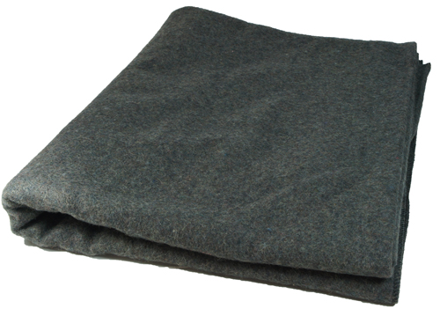
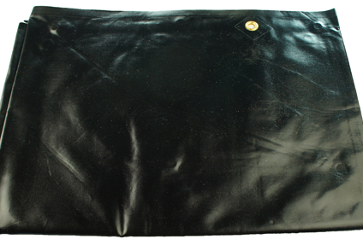
What They Carried
One Heavy Wool Blanket and
One Rubber Coated Gum Blanket
Why do you think soldiers carried these two types of blankets?
Notes:
Soldiers carried one heavy wool blanket to protect from the cold and one gum blanket.
The Gum Blanket is made of rubber coated canvas with edge grommets and is meant to go under your bedroll to insulates you from the cold and damp of the ground.

Slide 8
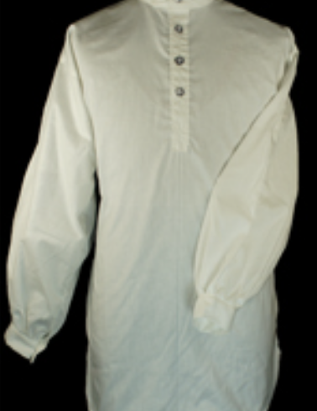
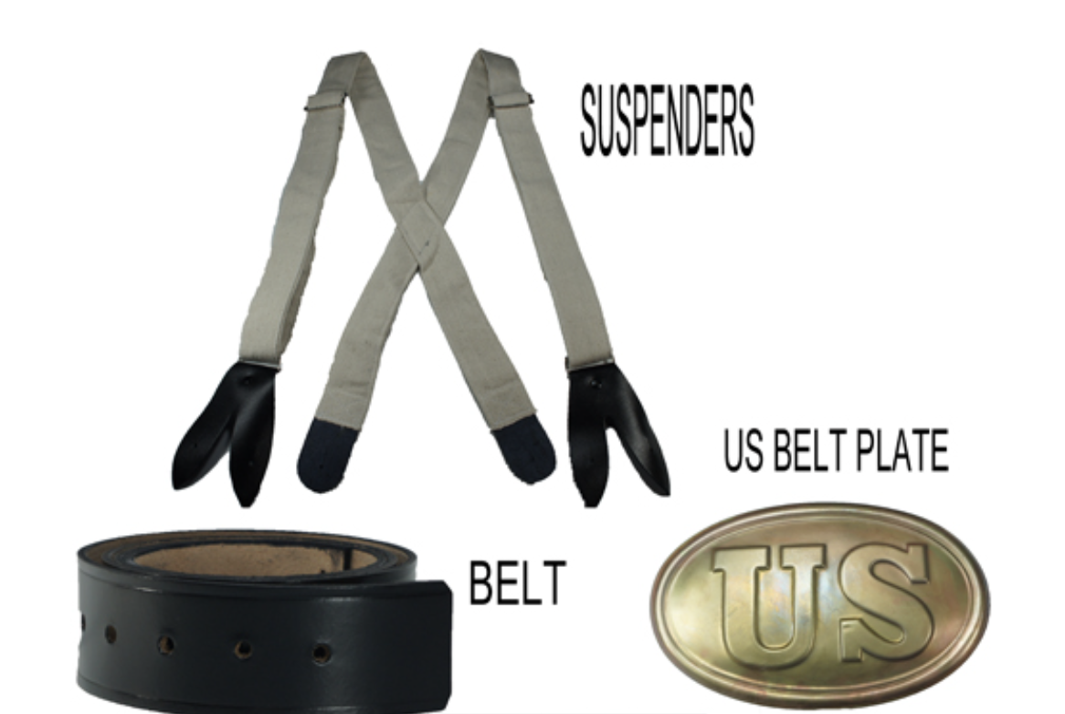
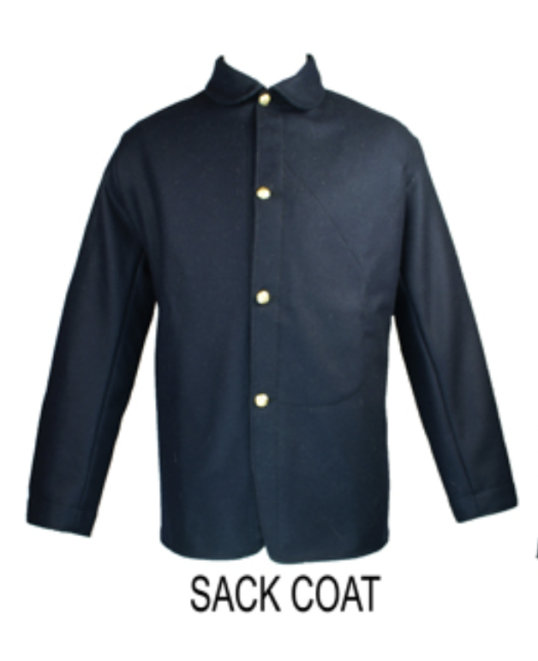
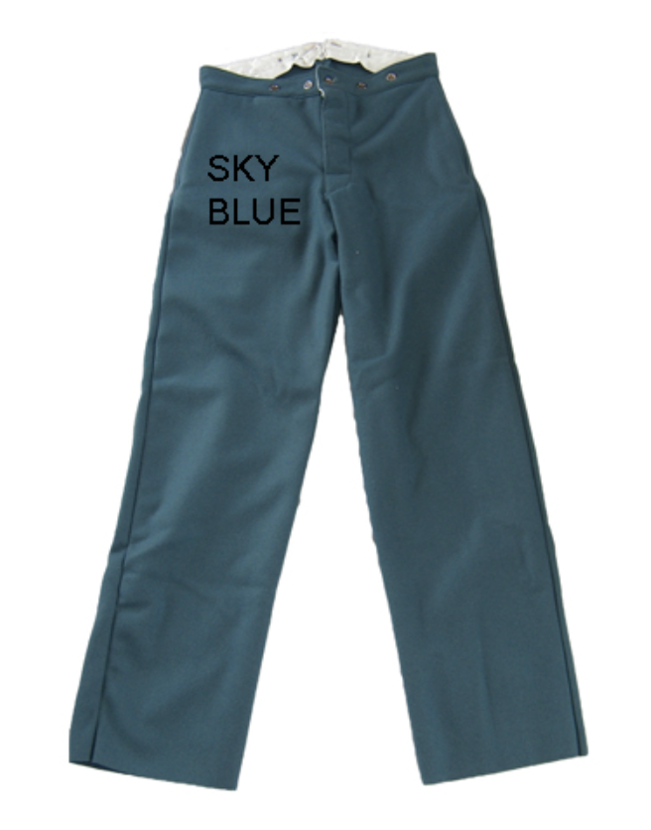
What They Wore: Union Soldiers
US Uniform - US Sack Coat(unlined) - Sky Blue Trousers - Fold Collar Shirt - Black leather Belt - US Belt Plate - Suspenders

Slide 9
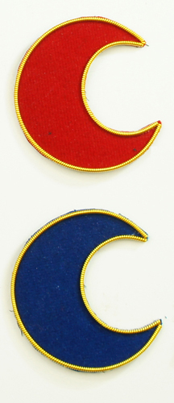
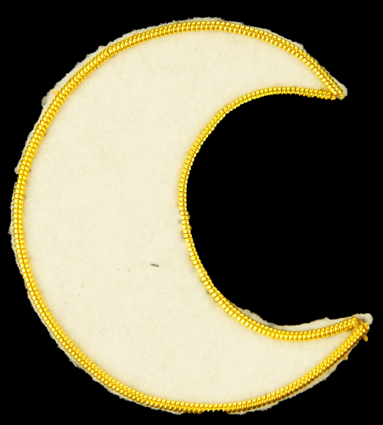
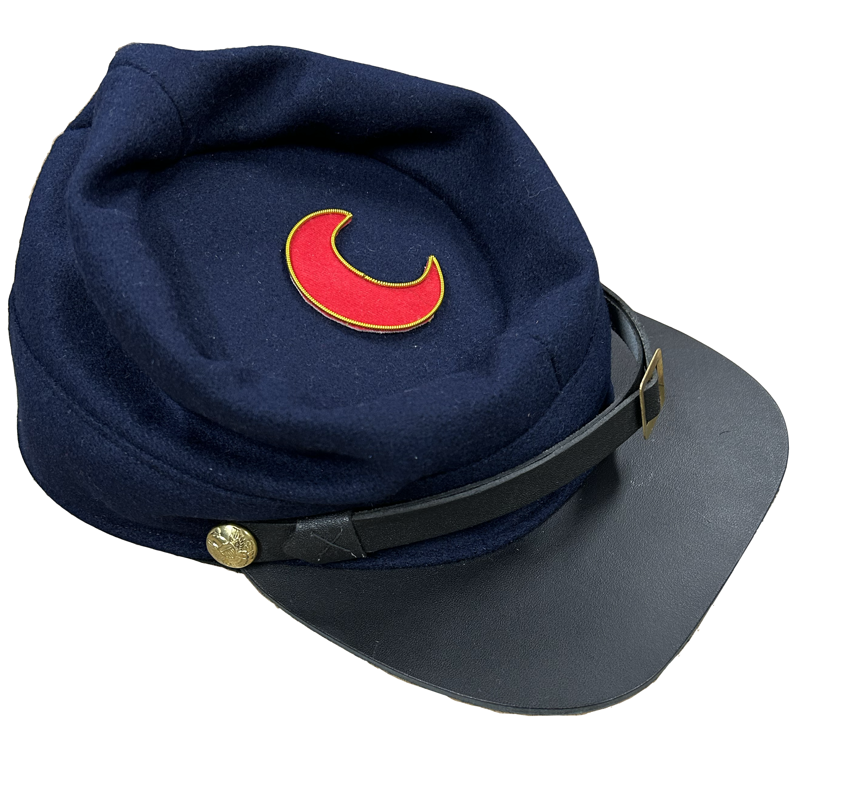
What They Wore: Union Soldiers
US Uniform: Kepi Hat
Why do you think wore these badges on top of their hats, and what do the colors mean?
Notes:
The crest badge symbolized that the soldier was with the 11th Corps (Badge Shown). Each Corps had its own distinct insignia. A Red Crest meant that they were in the 1st Division, while a White Crest represented the 2nd Division, and a Blue Crest represented the 3rd Division.

Slide 10
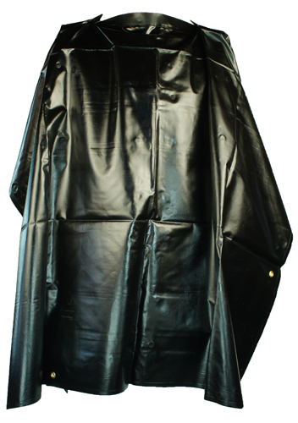
What They Wore: Union Soldiers
Rubber Coated Rain Poncho
Notes:
Soldiers carried Ponchos made with rubber coated canvas to protect them from the rain.

Slide 11
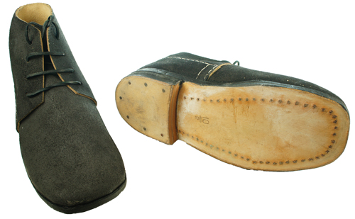
What They Wore: Union Soldiers
Leather Brogans
How many miles do you think a typical soldier would have to march in a day?
Notes:
Leather brogans were a common and essential part of a Civil War soldier's uniform, providing reliable and sturdy footwear for the demands of military service Brogans typically covered the entire foot up to the ankle and were made from durable leather.
To enhance the durability of brogans, strips of metal were often added to the heels. This metal reinforcement helped reduce wear and tear caused by marching and prolonged use. It was a practical measure to extend the lifespan of the shoes, considering the challenging conditions and long marches that soldiers endured during the war.
How many miles do you think a typical soldier would have to march in a day? Answer: On average, soldiers would march between 8 and 13 miles in a day, and on occasion, as much as 20 miles in a day.

Slide 12
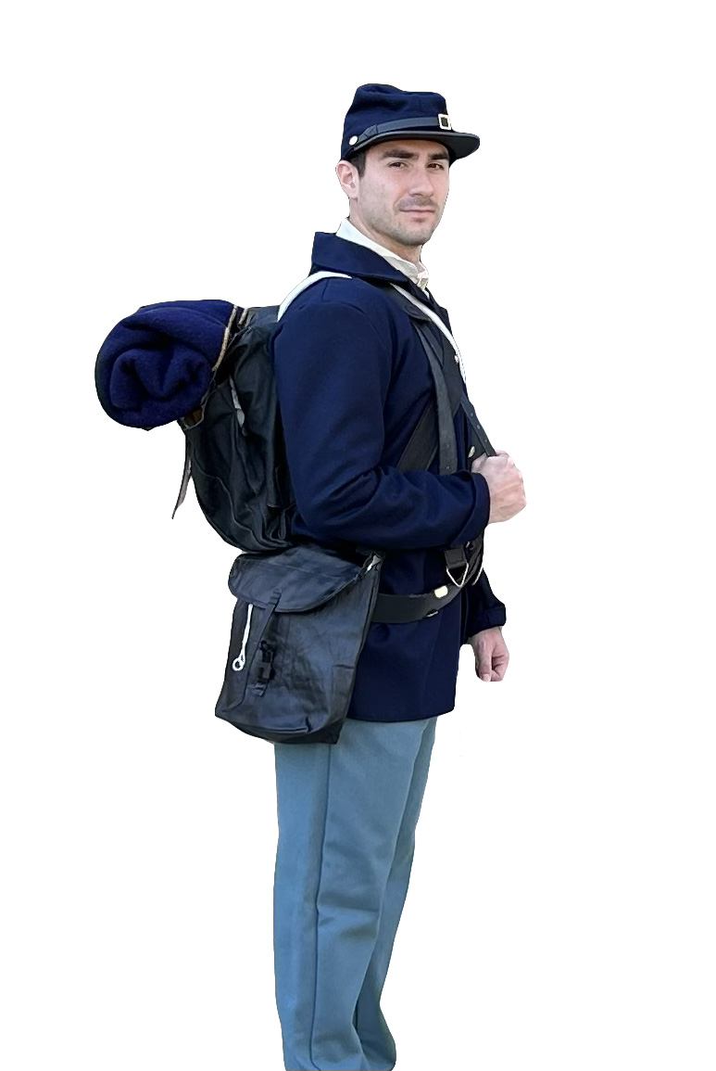
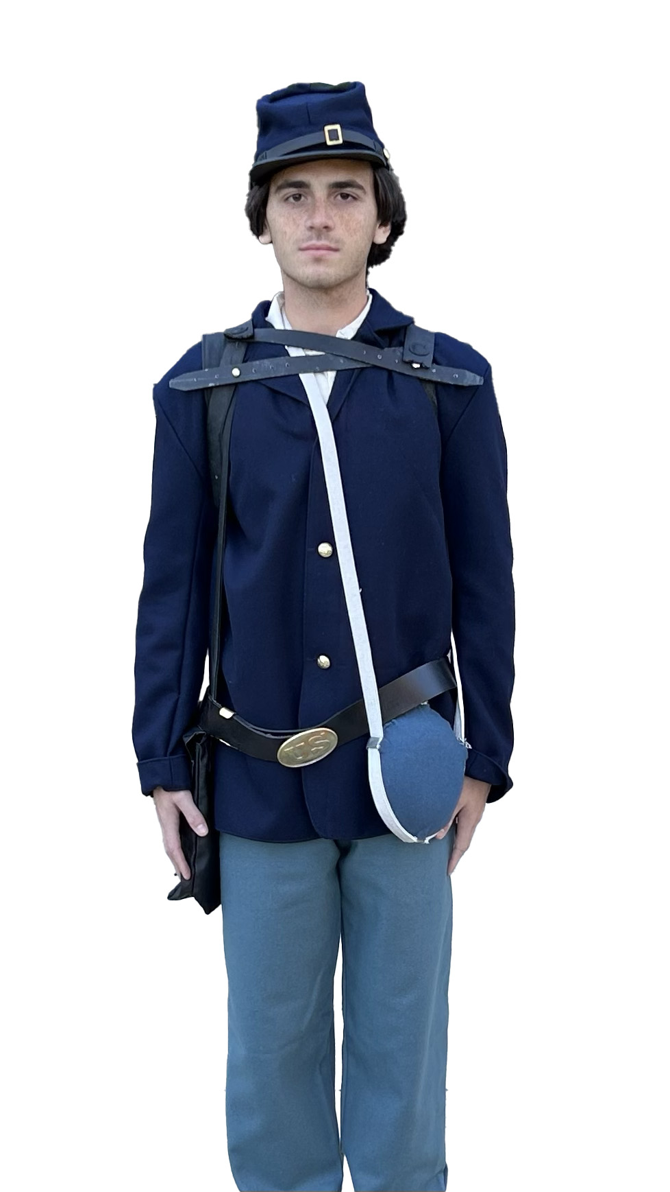
Civil War Calling:
The Lehigh Valley
Response
What They Carried
Notes:
This presentation is inspired by the American Battlefield Trust’s “Life at War” presentation and is intended to be shown with the replica uniform and backpack, available to Lehigh Valley educators through Reeves Library of Moravian University. We also highly recommend viewing the ABT’s “What they carried” video at https://www.battlefields.org/learn/videos/equipment-civil-war.

